Slide 1
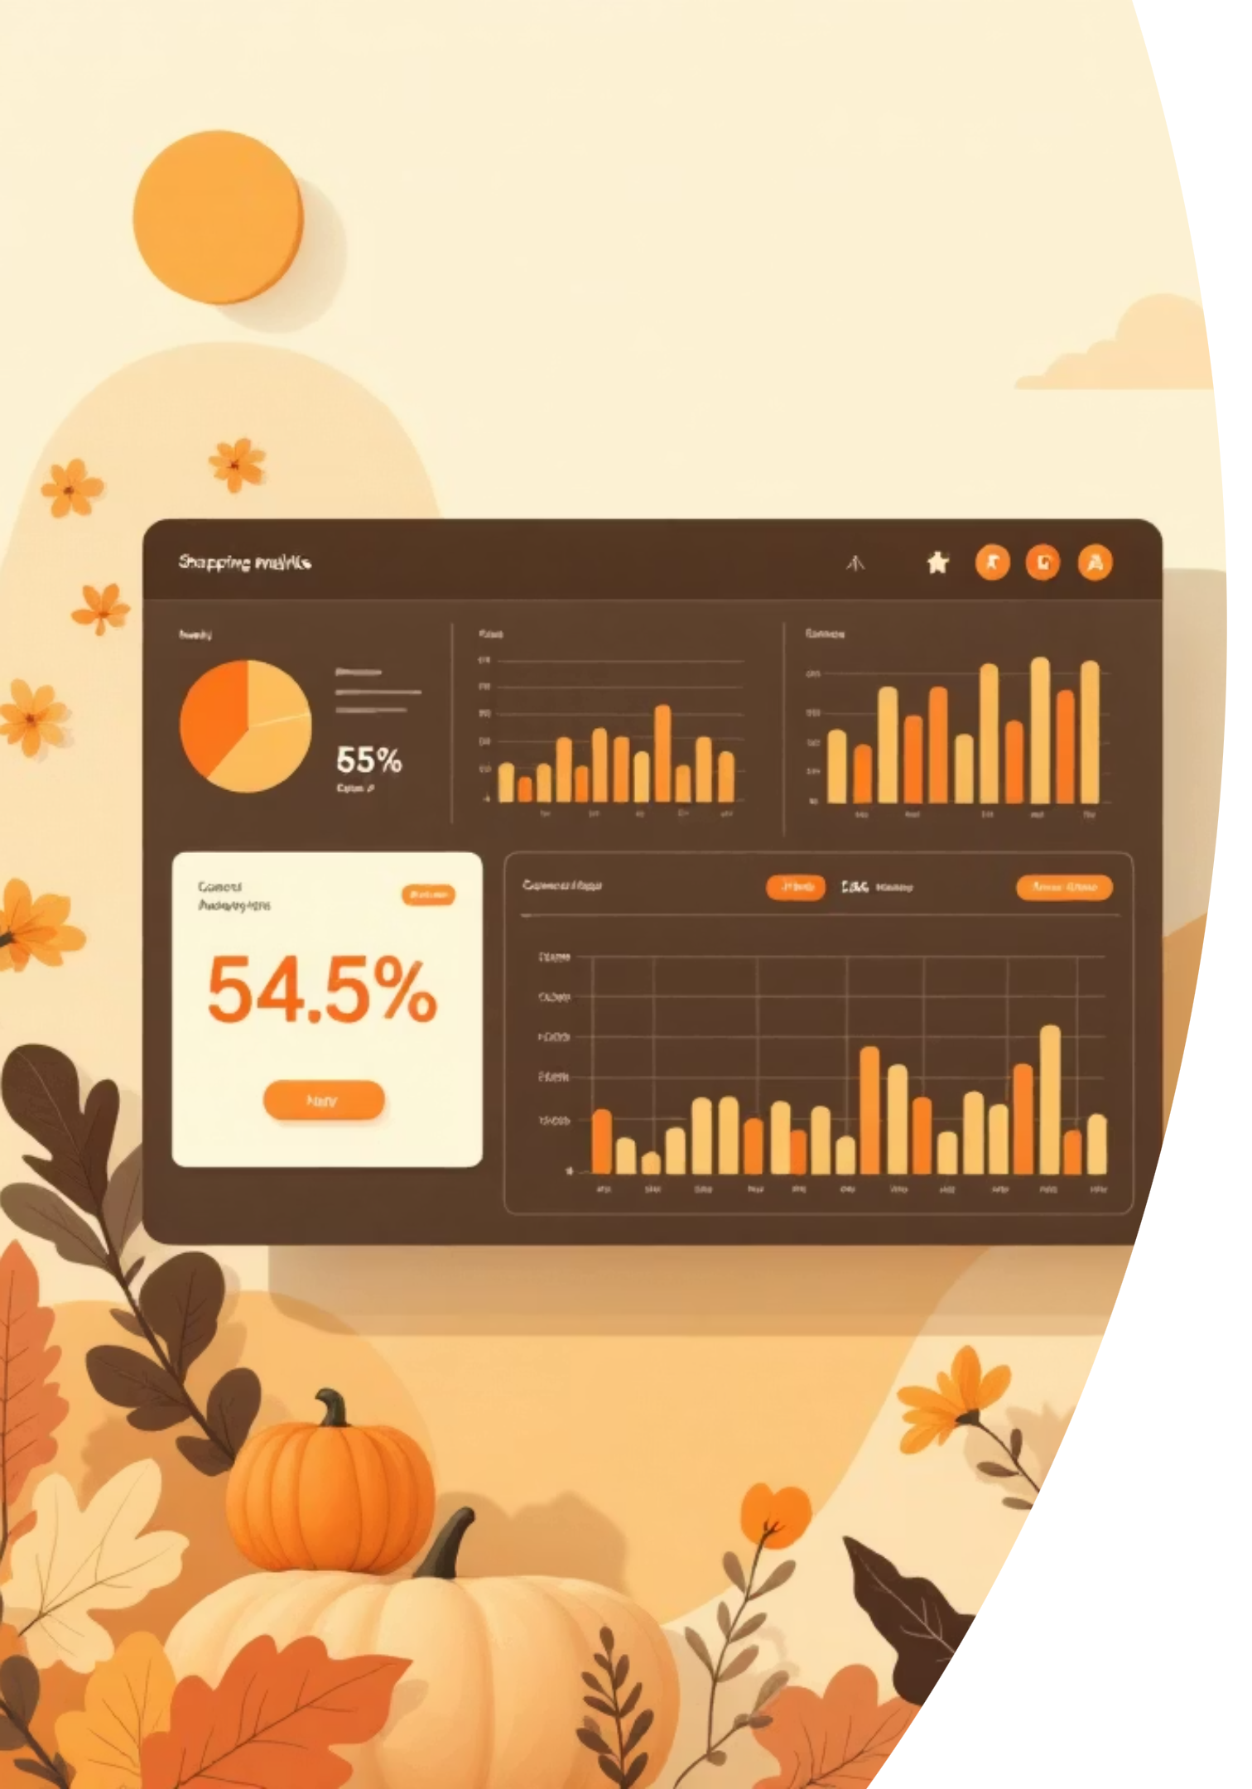
Customer Shopping Behavior Analysis
Uncovering insights from 3,900 purchases to guide strategic business decisions through data-driven analysis of spending patterns, customer segments, and product preferences.

Slide 2

DATASET OVERVIEW
Understanding Our Data Foundation
3.9K
18
50
Total Purchases
Key Features
Locations
Transactions analyzed
Data dimensions tracked
Geographic coverage
Core Data Categories
Customer demographics (Age, Gender, Location, Subscription)
Purchase details (Item, Category, Amount, Season, Size, Color)
Shopping behavior (Discounts, Previous Purchases, Reviews, Shipping)
Only 37 missing values in Review Rating column—excellent data quality for analysis.

Slide 3

PYTHON ANALYSIS
Data Preparation & Engineering
01
Data Loading & Exploration
Imported dataset using pandas, examined structure with df.info() and summary statistics
02
Cleaning & Standardization
Imputed missing Review Ratings using median by category, standardized columns to snake_case
03
Feature Engineering
Created age_group bins and purchase_frequency_days, dropped redundant promo_code_used column
04
Database Integration
Connected to PostgreSQL and loaded cleaned data for advanced SQL analysis

Slide 4
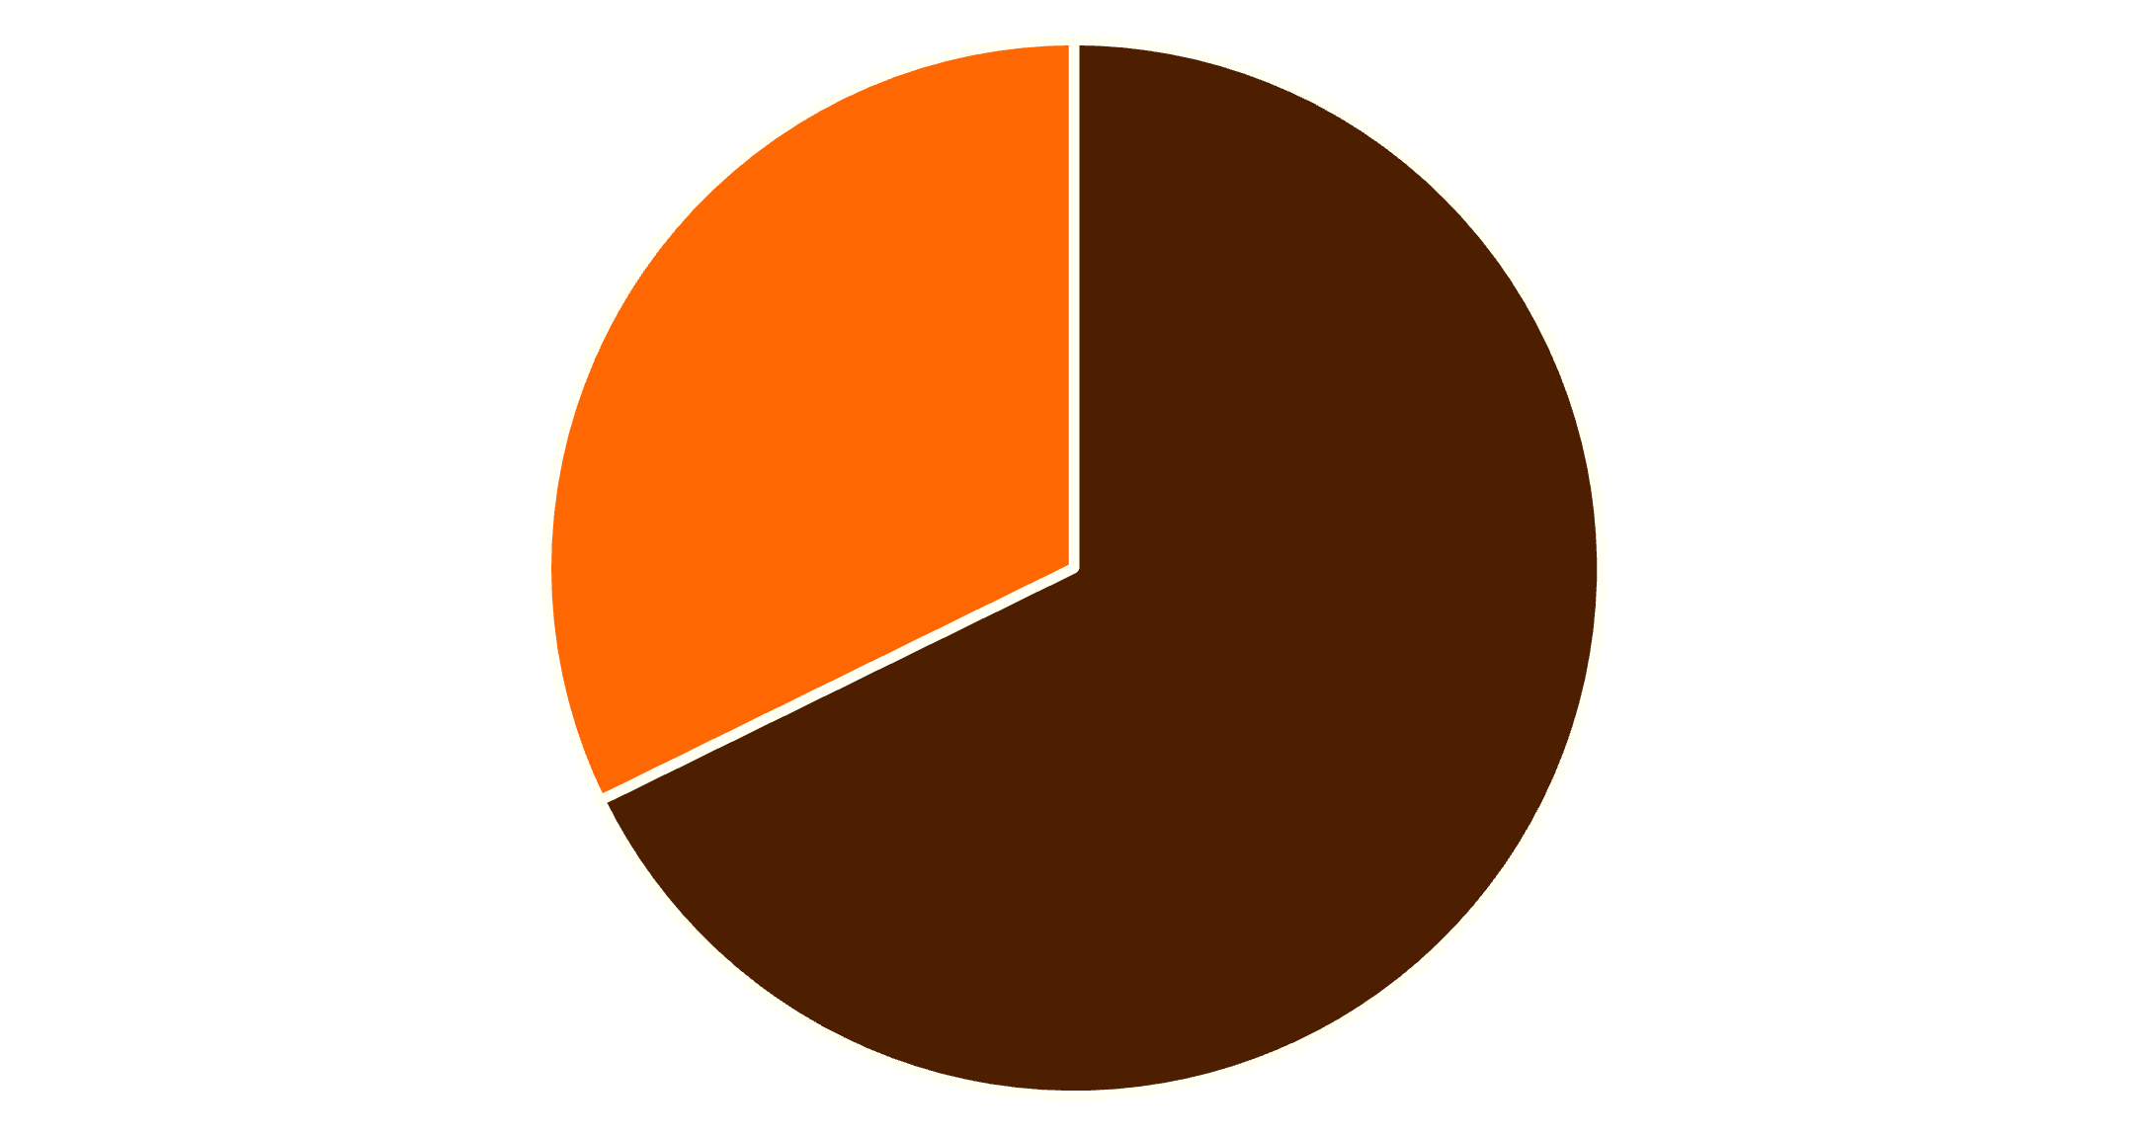

KEY INSIGHTS
Revenue & Customer Patterns
Gender Revenue Analysis
Male customers generate 68% of total revenue ($157,890) compared to female customers at 32% ($75,191). This significant disparity suggests opportunities for targeted marketing to balance customer engagement.
Strategic Insight: Consider campaigns specifically designed to increase female customer engagement and average purchase values.
Male
Female

Slide 5

Smart Discount Users
Identified 839 customers who used discounts but still spent above the $59.76 average—these value-conscious shoppers represent a key segment for retention strategies.
High-Value Discount Users
839 customers spending $60-$100 with discounts applied
Opportunity
Balance promotional offers with margin protection strategies

Slide 6




PRODUCT PERFORMANCE
Top-Rated Products & Category Leaders
Gloves
Sandals
Boots
Hat
Highest rating: 3.86 average
Strong performer: 3.84 average
Top footwear: 3.82 average
Popular choice: 3.80 average
These top-rated products should be prominently featured in marketing campaigns and inventory planning.

Slide 7
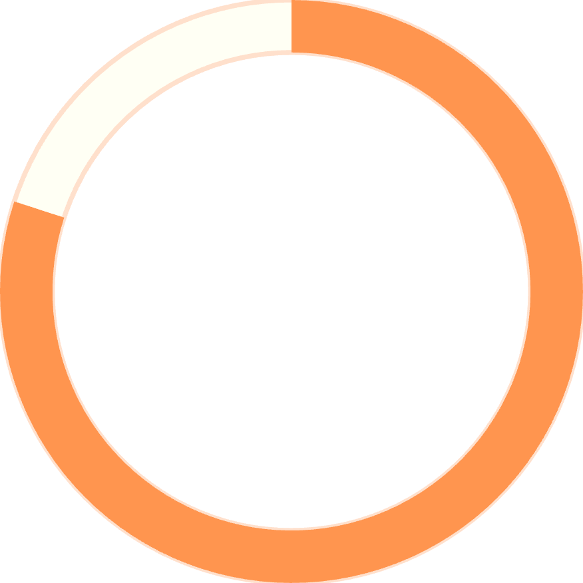
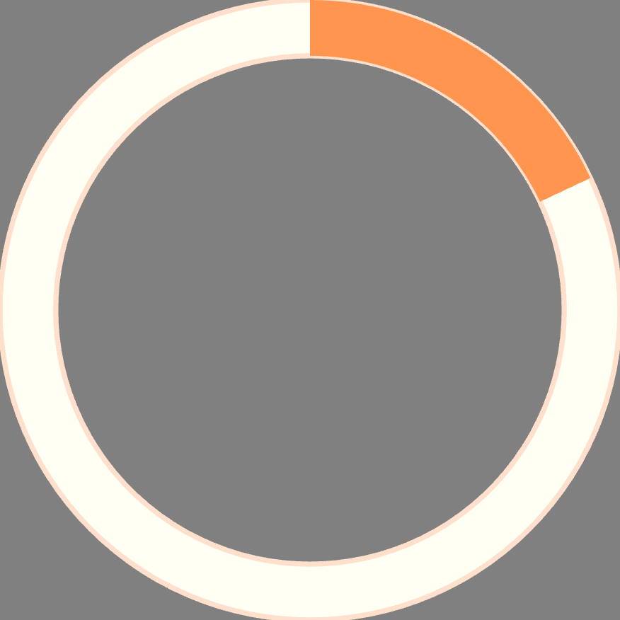
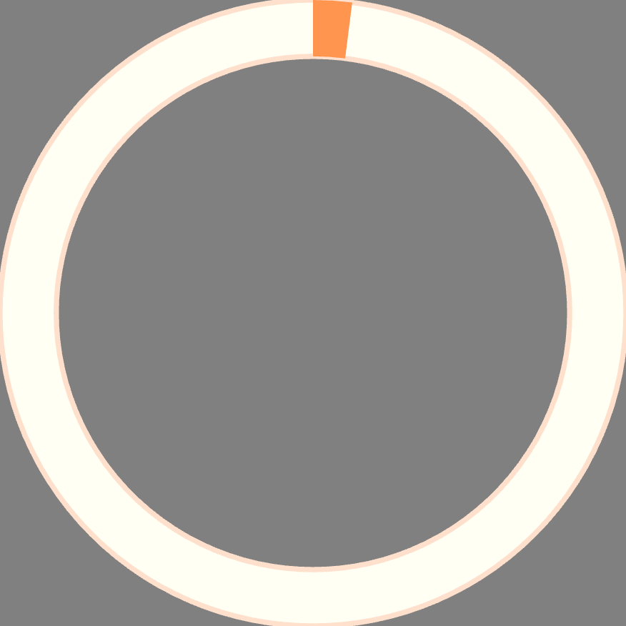
Customer Segmentation Insights
Three Distinct Customer Groups
80%
18%
2%
Loyal Customers
Returning
New
3,116 customers with 6+ purchases
701 customers with 2-5 purchases
83 first-time buyers
Strong loyalty base indicates successful retention, but only 958 of 3,074 repeat buyers subscribe—significant conversion opportunity exists.

Slide 8
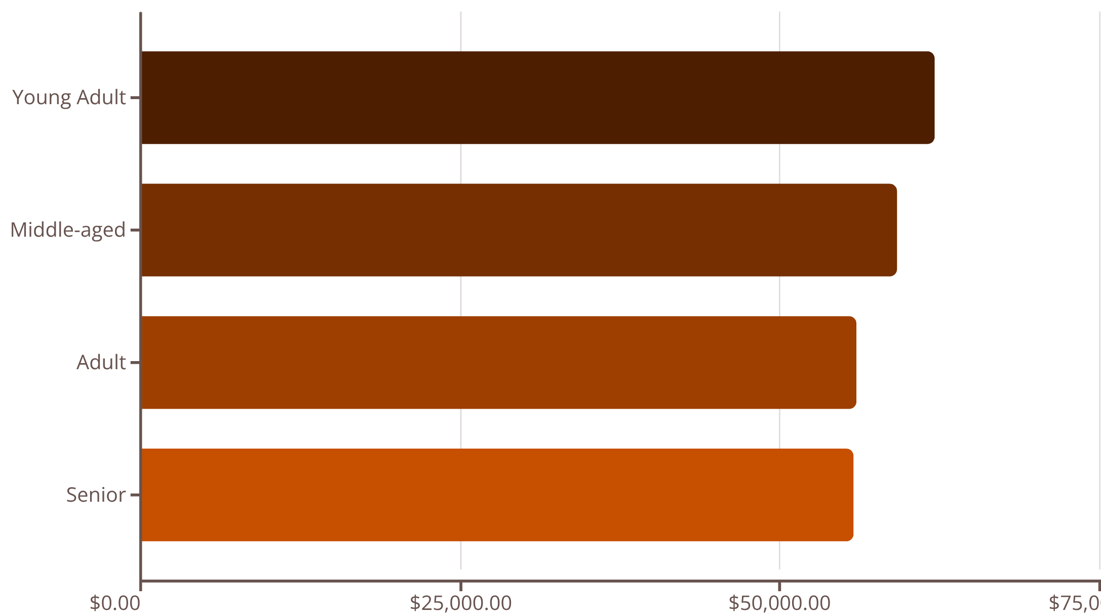
DEMOGRAPHICS
Revenue by Age Group
Balanced Age Distribution
Revenue is remarkably balanced across age groups, with Young Adults leading at $62,143. The narrow range ($6,380 difference between highest and lowest) suggests broad market appeal.
Shipping Preference: Express shipping users spend $2 more on average ($60.48 vs $58.46)—a small but meaningful indicator of customer urgency and willingness to pay.

Slide 9

Power BI Dashboard
Built an interactive visualization platform showcasing key metrics and enabling real-time filtering by gender, category, and shipping type.
Subscription Status
Category Performance
Interactive Filters
27% subscribed vs 73% non-subscribed customers
Drill down by demographics, shipping, and product categories
Clothing dominates with ~$100K revenue and 1,800 sales

Slide 10
ACTION ITEMS
Strategic Recommendations
Boost Subscriptions
Loyalty Programs
Review Discount Policy
Promote exclusive benefits to convert the 2,518 repeat buyers who haven't subscribed yet
Reward repeat buyers to accelerate movement into the "Loyal" segment
Balance sales boosts with margin control—839 high spenders use discounts effectively
Product Positioning
Targeted Marketing
Feature top-rated items (Gloves, Sandals, Boots) prominently in campaigns
Focus on Young Adults and express-shipping users for premium offerings

